Slide 1

Introduction
Project Name:- PRAYAS Introduction about project :-
Welcome to PRAYAS – Your Daily Dose of Positivity!
Life can be overwhelming, and it's easy to feel stuck in a cycle of negative emotions. That’s why we created PRAYAS — a website designed to help you rediscover happiness, one small step at a time.
ABOUT ME:-
At PRAYAS, we believe that even the tiniest actions can lead to significant transformations. By assigning you simple, achievable mini-tasks every day, we help you take small but meaningful steps toward a brighter and more fulfilling life. Whether it’s writing down three things you’re grateful for, taking a five-minute mindfulness break, or doing something creative, these tasks are carefully crafted to promote positivity, self-awareness, and growth.
RUSHIKESH TARPE
SEC : A (3rd)year

Slide 2

Abstract
PRAYAS is a transformative platform designed to support individuals struggling with depression by promoting positivity and personal growth through engaging mini-tasks. The website aims to cultivate small, achievable wins that contribute to an improved mental state over time.

Slide 3
Propose Design :-
PRAYAS is designed to help individuals manage depression through small, achievable tasks, promoting positivity and emotional growth.
Core Design Principles:
Simplicity: Intuitive interface and personalized mini-tasks.
Micro-Steps: Small, actionable tasks to build momentum.
Gamification: Rewards and progress tracking to inspire engagement.
Emotional Support: A safe community space and uplifting messages.
Accessibility: Mobile-friendly and inclusive for all users.

Slide 4

Small Tasks: Powerful Tools in the Fight Against Depression
1
Gratitude Journaling:
2
Mindful Breathing:
Task: Write down three things you are grateful for today. They can be big or small (e.g., "I’m grateful for my morning coffee," or "I’m grateful for my friend’s kind message").
Task: Take 5 minutes to focus on your breathing.
Inhale deeply for 4 seconds, hold for 4 seconds, exhale for 4 seconds, and repeat.
3
Compliment Yourself:
Task: Write down one thing you like about yourself or something you’ve done recently that you’re proud of.

Slide 5
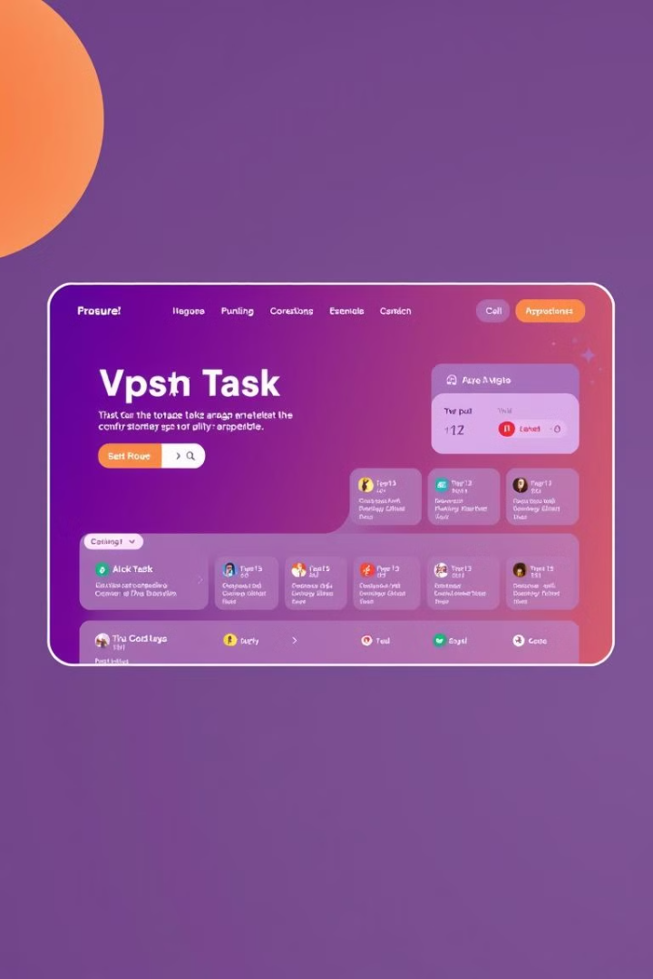
Implementation Plan (MERN Stack) :-
Front-End: React for UI, Tailwind for styling, and Context API or Redux for state management.
Back-End: Express.js for APIs and task logic.
Database: MongoDB (via Mongoose) for storing tasks, mood logs, and user data.
Core Features:
Task generator, mood tracker (Chart.js), gamification (badges/progress), and community space (Socket.IO for chats).
Authentication: Secure with JWT and bcrypt.js.
Deployment: Host on Vercel (front-end) and Render/Heroku (back-end).
Testing: Use ThunderClient for APIs and Cypress for UI tests.
Security: Encrypt data and secure environment variables with dotenv.

Slide 6
Literature Survey

Slide 7

Results :-
High user engagement through personalized tasks and mood tracking.
Gradual improvement in mental health and reduced isolation via community support.
Detailed mood patterns and task analytics for user reflection.
Scalable, user-friendly platform to accommodate growth.
Strong user retention through gamification and meaningful rewards.

Slide 8
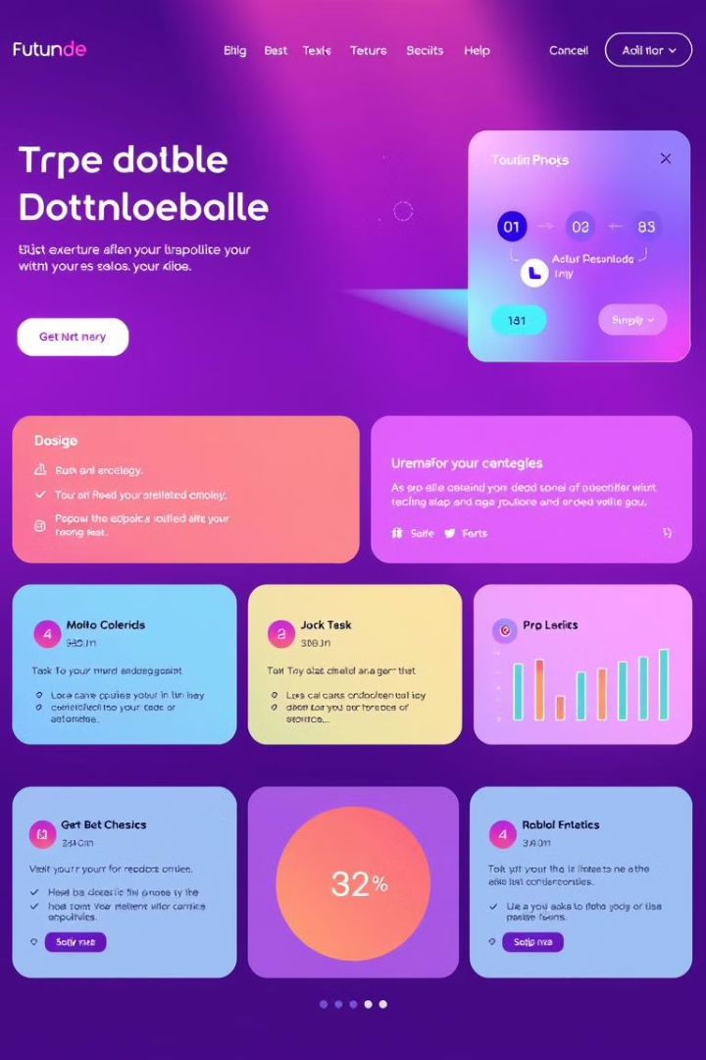
Conclusion :-
PRAYAS is designed to be a transformative platform that empowers individuals to improve their mental well-being through small, meaningful actions. By combining evidence-based practices like behavioral activation, gamification, and community support, PRAYAS fosters gradual and sustainable emotional growth.
Its user-friendly interface, personalized tasks, and interactive features ensure high engagement and long-term impact. As a scalable and secure platform, PRAYAS has the potential to bring hope and positivity to countless lives, making it a valuable tool in addressing mental health challenges in a digital age.

Slide 9

Thank You..!

